Slide 1

NESTLÉ × WISER QUANTUM CHALLENGE '2026
A HYBRID CLASSICAL + QUANTUM APPROACH
Quantum Optimization for
Distributed Order Management
TEAM
The Convergents
Harika Yanamadala, Induja Bhanu Kodavati
Demo day · September 24, 2026

Slide 2
THE PROBLEM
When the default warehouse can't finish the order?
A default DC runs short on inventory, dock slots, throughput or picking constraints. Each order must go to its default DC, one of two alternates, or stay unassigned - while every order competes for the same scarce capacity.
TWO DATA TRAPS WE CAUGHT
Revenue is a line total, not a per-case price
Input data provides total order line value. Multiplying by shipped cases artificially inflates the objective function by ~10× across solvers.
Fix: Normalized revenue by ordered quantity to derive exact per-case value prior to solver ingestion.
GLOBAL OBJECTIVE FUNCTION
Maximise (Revenue - Penalty - Shipping) across every open order
WHY IT IS COMBINATORIAL
Planner history is 99.7% Default Bias
5 orders
25 orders
82 orders
Historical log contains 1,106 default assignments and only 3 diversions. A "never-divert" baseline scores 99.7% agreement while optimal diversions receive F1 = 0.
Fix: Benchmarked all solvers against an exhaustive 1,024-combination certified brute-force optimum.
1,024
10¹⁵
astronomical
→
→
brute force is tractable
exhaustive search fails
a real focus-order window
Nestlé × WISER 2026 · The Convergents
2

Slide 3
OUR APPROACH · PIPELINE
Hybrid Architecture : Two solvers, one ground truth
STEP 1: FORMULATION
Decision Matrix Formulation
QUANTUM ARM
QAOA - Qiskit Aer
STEP 3: EVALUATION
Ground Truth
STAGE 2A
XY-Mixer QUBO Formulation
XY mixer, not penalties: The circuit only ever explores the feasible one-hot subspace, making "one DC per order" structural without penalty weight tuning.
STAGE 2B
CVaR Optimization
CVaR tail objective (α = 0.20): COBYLA optimises the top 20% of shots, steering past shot noise instead of being dragged down by bad samples.
1,024
Scored against a certified optimum derived from exhaustively evaluating all feasible assignments.
CLASSICAL ARM
MILP - PuLP + CBC
One column selected per order
PLUS
Baseline 1
strict default DC
Baseline 2
greedy divert
5 focus orders × 4 candidate columns = 20 binary decision variables.
STAGE 2A
Full 7-Constraint Formulation
All 7 constraints native: Inventory,, case/pallet picking, dock capacity and C4 divert hurdle modeled as exact linear constraints.
STAGE 2B
CBC Branch-and-Cut Solve
Deterministic and unbounded: No qubit ceiling and no seed dependence - returns the same optimal answer in under a second, every run.
Identical objective fed to both solver arms.
run through the identical evaluation pipeline.
Nestlé × WISER 2026 · The Convergents
3

Slide 4
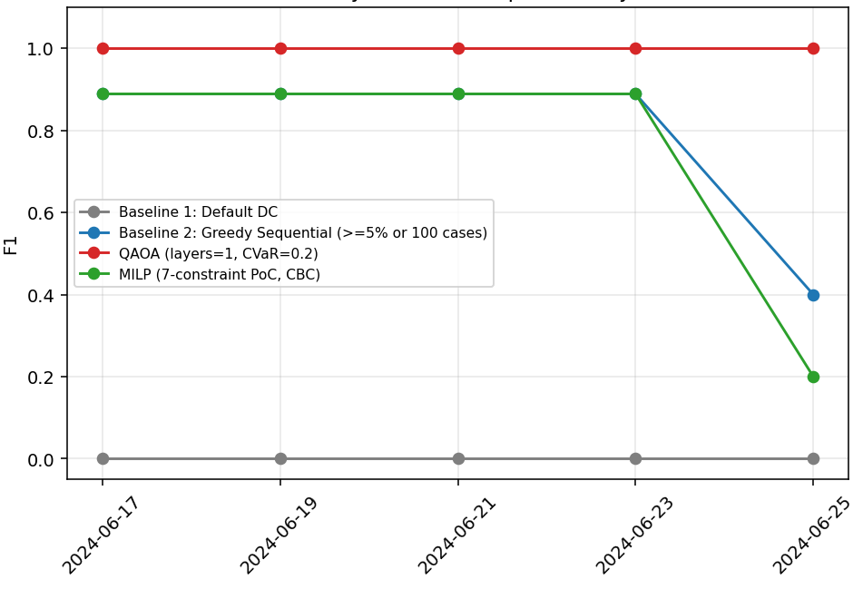
BENCHMARK RESULTS
Four dates look identical. The fifth separates the solvers.
Solver pipeline | Mean profit | Gap | Fill | F1 | Runtime
Baseline 1 · strict default DC | $181,865 | 75.1% | 19% | 0.000 | 0.01s
Baseline 2 · greedy sequential | $896,014 | 0.8% | 89% | 0.791 | 0.01s
MILP · 7-constraint PoC (CBC) | $894,713 | 1.0% | 88% | 0.751 | 0.99s
QAOA · XY-mixer, CVaR 0.20 | $900,954 | 0.0% | 89% | 1.000 | 16.77s
F1 vs. certified optimum, by planning date
Scored against a certified brute-force optimum · cumulative profit across the five dates ≈ $4.5M
WHY AVERAGES MISLEAD HERE
On the four easy dates (06-17 –> 06-23) QAOA sits at 0.00% gap while MILP and greedy both sit at 0.18% - nearly identical in profit.
KEY DIVERGENCE · 2024-06-25
The tight-bottleneck date, drawn from order window.
Root cause of the divergence: a modelling choice, not randomness. MILP's explicit C4 divert hurdle is structurally conservative under tight capacity; QAOA's global QUBO landscape keeps navigating the trade-off. The optimum ignores C4, which blocks 3 of 5 optimum diverts on 06-25.
QAOA (quantum)
Baseline 2 (greedy)
MILP (CBC)
F1 = 1.000
F1 = 0.400
F1 = 0.200
0.00% gap
3.05% gap
4.18% gap
Nestlé × WISER 2026 · The Convergents
4

Slide 5
LIMITATIONS + INSIGHTS
Honest limits: Noise, Ceiling, Variance
NOISE SENSITIVITY
100% → 94.1% → 77.3% → 37.5%
in-subspace shots at 0%, 0.1%, 0.5%, 2% gate error (12-qubit test)
Fully-feasible shots fall in step - from ≈56-71% ideal to ≈19-26% at the highest error rate tested.
The XY mixer's constraint-preservation holds only under ideal, noiseless execution - these are simulator-best-case results, not hardware-ready ones.
SIMULATOR CEILING
State-vector simulation caps at ~25 qubits (5-6 orders).
The full 82-order pool would need 328 qubits - linear growth, but past our reach today.
Exact simulation complexity scales exponentially with qubit count, imposing strict boundary limits for classical validation.
MULTI-SEED VARIANCE
F1 standard deviation peaked at ~0.05 (recall ~0.09) on 06-19 and 06-21.
Across seeds {1, 7, 13, 42, 101} performance varies non-trivially.
QAOA is not seed-invariant even noiseless.
Requires multi-seed benchmarking to check stability in operational deployments.
WHAT'S PRACTICAL TODAY
MILP is the arm we would deploy now.
Deterministic, 15-20× faster, no qubit ceiling, and stays within 0.2-4.2% of optimal.
KEY DEPLOYMENT ADVANTAGES
✓ Sub-second response on tested instances
✓ No qubit-based ceiling; scales with classical compute
✓ No quantum-hardware noise
Nestlé × WISER 2026 · The Convergents
5

Slide 6

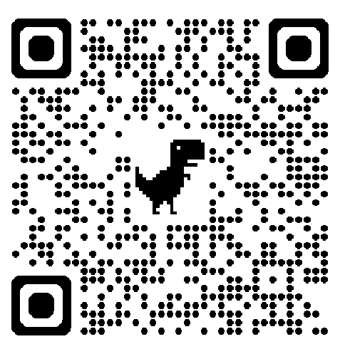
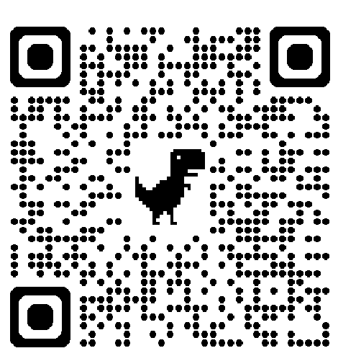
CONCLUSION & NEXT STEPS
Classical today, quantum-ready for large-scale testing
QAOA matched the certified optimum on all five dates; MILP is 15-20× faster with no qubit ceiling. What scales is the methodology - certified-optimum scoring, multi-seed robustness and per-order planner views carry straight to the full order book. In practice: fewer manual overrides, and diversions that manual planning could otherwise miss.
01
02
03
04
Column reduction
Problem batching
Error mitigation
Hybrid future Architecture
Prune dominated candidate DCs before the QUBO is built - fewer qubits, no loss of optimality.
Partition the 82-order pool into clustered ~5-order subproblems to bypass the simulator limit.
Zero-noise extrapolation and readout calibration on real QPUs to suppress subspace leakage.
MILP for current operations; evaluate QAOA on larger, high-contention instances, and quantum-AI can be used for automation.
Interactive planner app
domplanner-convergence.streamlit.app
Repository
github.com/HarikaYanamadala/The_Convergents_Nestle_DOM
Thank you.
The Convergents · Harika Yanamadala & Induja Bhanu Kodavati

